Slide 1
“They must understand us as sex workers”: health service perspectives among female sex workers in the context of PrEP and early ART introduction in the TAPS Demonstration Project, South Africa
Background and Methods
Female sex workers are a focus of specialised programming in South Africa as a key population (SANAC National Plan)
Focus group discussions as part of formative research to explore experiences with health services and gather input on best practices
In two sites, snow ball sampling through peer educator social networks
Authors: Robyn Eakle, Adam Bourne, Gabriela Gomez,
Francois Venter, Helen Rees

Slide 2
Results - Demographics
6 FGDs; 69 participants; ages 22-60 (avg 35)
24% Gauteng province; 45% other provinces; 31% cross boarder migrants;
At least some school (96% secondary); almost all single (93%)
Results- Perspectives
Accessibility through mobile clinics was an important to include in flexible services
Past experiences of
stigma and discrimination cited as major barrier to PrEP and early ART – “Feeling free” is very important
Peer-led/
supported services highlighted as best practice

Slide 3
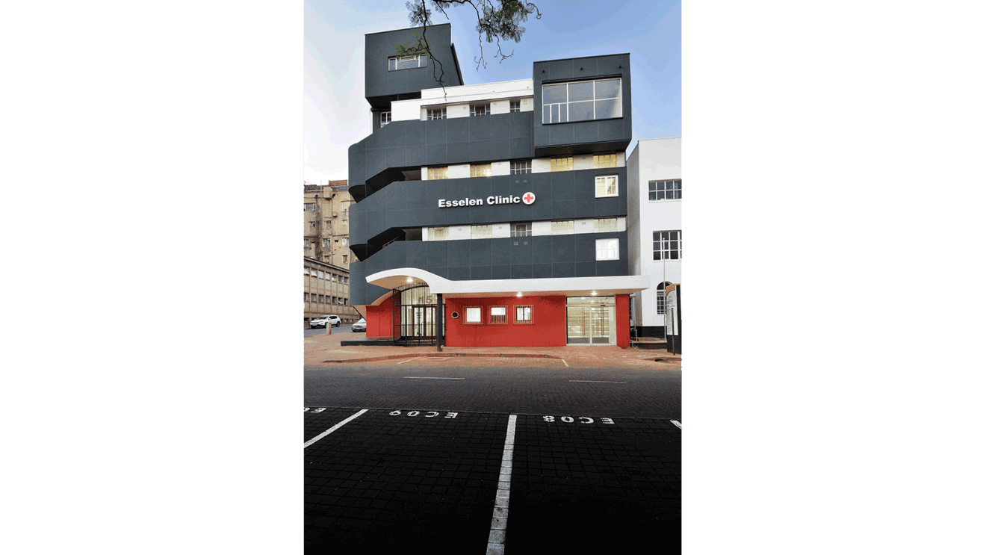
Conclusions
Critical to address stigma for successful PrEP and early ART implementation
Sex workers must be involved in developing and delivering the interventions
Acknowledgements
Participants; TAPS staff; Co-authors;
Bill & Melinda Gates Foundation

